Slide 1
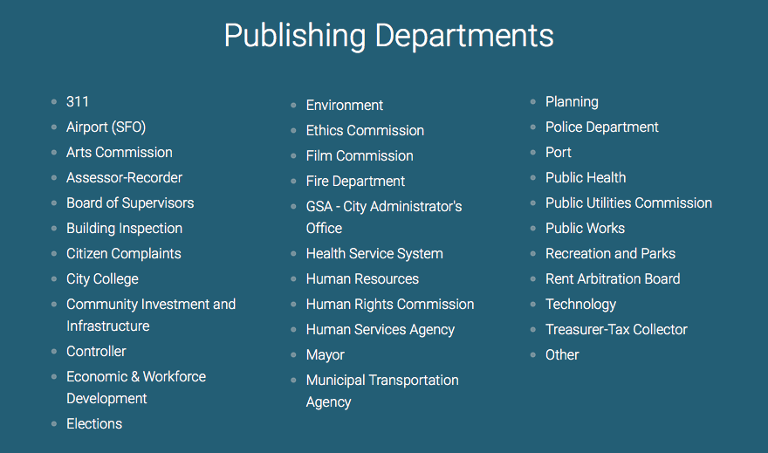
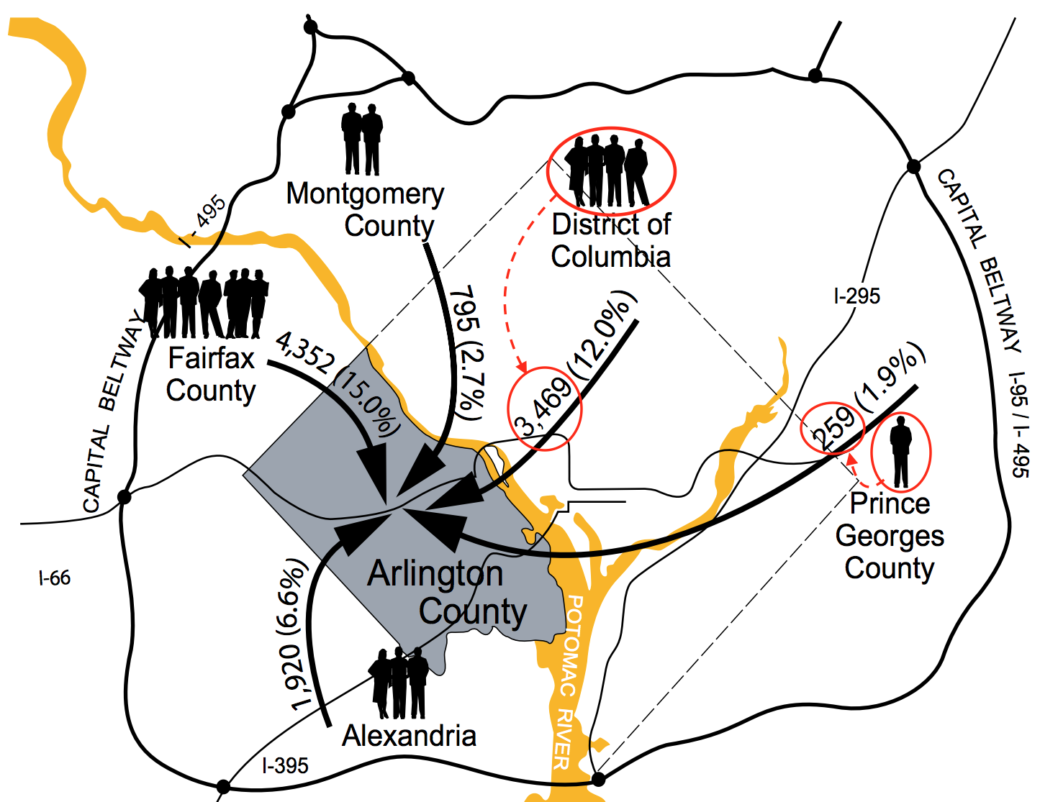
Criteria for an Excellent Open Data Portal
Data Science for the Public Good
Mark Almanza (Virginia Tech), Madison Arnsbarger (Virginia Tech), Jessica Flynn (Cornell), Millicent Grant (Iowa State University), Adrienne Rogers (Virginia Tech), William Sandholtz (UC Berkeley), Emily Stark (Austin Peay), Samantha Tyner (Iowa State U) with Gizem Korkmaz, Katie Ziemer, & Stephanie Shipp (SDAL), and Kristanne Littlefield, Arlington Chief Digital Officer
Goals
“Open Data,” which is any publicly available information, has the potential to improve government efficiency, advance local businesses, and facilitate more frequent and deeper use of government data.
Arlington County asked students in the Data Science for the Public Good Program (DSPG) at SDAL for feedback regarding their newly-released Open Data Portal.
The students developed a set of criteria that could be used to develop and improve any open data portal to aid in the evolution and improvement of general Open Data Portal standards.
Criteria
Website Design
USER INTERFACE
A simple palette of high contrast colors should make up the bulk of the site, leaving many colors available as accents.
The site’s color palette should remain consistent throughout the site to aid in navigation and to appear more unified.
An Open Data Portal should be easy to read, with text in a font and color that are easy to look at for extended periods of time.
Aa
Organization
Web pages and datasets are organized consistently and logically
  File hierarchy is clear and lists are sorted properly
Users are given appropriate context
  Descriptive information included
The physical set up of the structure of the website.
Data Tidiness
Navigation
Easily accessible from the main webpage
Explicitly labelled button to return to Open Data Homepage
Ability to search and move through files based on file type, category, or keyword
Name | Sex | Date of Birth | Height (in) | Start Year | End Year
Amanda | F | 03/07/1968 | 66 | 1990 | 1996
Bradley | M | 11/05/1971 | 70 | 1994 | 1999
Connor | M | 07/17/1964 | 68 | 1988 | 1992
Danielle | F | 10/22/1970 | 67 | 1997 | 2005
The interactive elements of the website guiding the user through the database.
Design
Easy to read
Consistent visual environment
Section headers should be easily viewable from the homepage
Different types of data and different types of visuals should be differentiable at a glance
The use of any tool presented to the user should be clear
Color coding tools is encouraged
This table is in a tidy format: each row represents a different observation, and the columns record various characteristics about each person such as date of birth, sex, or height.
If a column contains a range of values, the column should be split into two separate columns - one for the minimum, and one for the maximum values of that range.
While it is open for debate whether the responsibility of tidying data is that of the Open Data Portal administrator, depending on the goal and maturity of the organization supporting the portal, making the data tidy would facilitate better and more frequent use of the content.
The visual elements of the website’s design and flow
DATA
Data Documentation
Tidiness
Each Variable forms a column
Each Observation forms a row
Common dataset tidiness tips:
Columns represent variables not values; one column contains only one variable; variables are stored in only columns, not rows;
More tidy suggestions:
Keep units in column headers; make sure variables are internally consistent; format special data types in a consistent manner.
Proper documentation answers questions about where the data came from and how it was collected.
Displaying a list of commissions, agencies, and other government organizations that have shared their data on the site may enhance the credibility of the portal.
The description of each dataset should contain information about the origin of that data.
The quality and usability of the datasets
Accessibility
Restrictions/licenses removed
Headers give full explanation of dataset
Personally Identifiable Information (PIIs) are accounted for
Public APIs and code are available and usable
Data Visualization
The ability to get to, understand what is in the and share the data
The “junk” items here are the people icons, which represent the flow of people migrating into Arlington County from surrounding areas in 2012.
Although the number of people coming from DC is more than 13 times the amount of people coming from Prince Georges County, there are only 4 person icons to represent that difference. This misleads the viewer.
Better options would be to remove the people and make the numbers more prominent, or to have a legend indicating how many people each person icon represents.
Documentation
Dataset contents are described in clearly labeled metadata
All sources are clearly published
Dataset summaries are available
Download File Type is clearly labeled
The background information of the dataset
Visualization
All Visualizations:
Clearly labeled
Remain true to the data
Avoid “chartjunk”
Creating Visualizations
Users can access the data visualization creation tools quickly and easily
Tools provided for visualization are clearly labeled and easy to navigate
The visual elements of the dataset
References
[1] Open Data Portal Requirements. (n.d.). Retrieved June 03, 2016, from http://labs.centerforgov.org/open-data-portal-requirements/
[2] Open Data Policy Guidelines. (n.d.). Retrieved June 03, 2016, from http://sunlightfoundation.com/opendataguidelines/
[3] City Open Data Policies. (n.d.). Retrieved June 3, 2016, from http://www.nlc.org/Documents/Find City Solutions/City-Solutions-and-Applied-Research/CSAR Open Data Report FINAL.pdf
[4] Lynch, P. and Horton, S. (2011) Web Style Guide Retrieved from http://webstyleguide.com/wsg3/4-interface-design/3-interface-design.html
bi.vt.edu/sdal
Notes:
Proper documentation communicates the credibility of an Open Data Portal by answering questions such as where the data came from and how it was collected. Displaying a list of commissions, agencies, and other government organizations that have made their data publically available on the site may enhance both the attractiveness and the credibility of the portal. In addition, the description of each dataset should contain information about the origin of that data.
This table is in a tidy format: each row represents a different person (observation) and the columns record various characteristics (variables) about each person such as date of birth, sex, or height. A tidy format should have one column for each variable, and contain the corresponding value in each row. If a column contains a range of values, the column should be split into two separate columns - one for the minimum, and one for the maximum values of that range – as above. While it is open for debate whether the responsibility of tidying data is that of the Open Data Portal administrator or the user, tidy data portals may attract more users than portals that require users to tidy the data themselves. Depending on the goal and maturity of the organization supporting the portal, making the data tidy would facilitate better and more frequent use of the content.
A simple palette of high contrast colors should make up the bulk of the site, leaving many colors available as accents. Additionally, the site’s color palette should remain consistent throughout the site to aid in navigation and to appear more unified. An Open Data Portal should be easy to read, with text in a font and color that are easy to look at for extended periods of time.
The “junk” items here are the people icons that were added to the graph. These icons represent the flow of people migrating into Arlington County from surrounding areas in 2012, but those values are also represented numerically in the same view. This reveals that, although the number of people coming from DC is more than 13 times the amount of people coming from Prince Georges County, there are only 4 person icons to represent that difference. This misleads the viewer. Better options would be to remove the people and make the numbers more prominent, or to have a legend indicating how many people each person icon represents, and have the appropriate number of icons for each region.

